Slide 1
Smart Traffic Management System for Urban Congestion (AI-Enabled Traffic Control & Accident Hotspot Mapping)
CSE7302- Capstone Project
Review-5
SIH:25050
Batch Number: CSE_120
Roll Number | Student Name
20221CSE0075 | Hemanth G
20221CSE0224 | Harsha Vardhana T
Under the Supervision of,
Dr. Mohammed Mujeer Ulla &
Mr. Tanveer Ahmed
Associate Professor
School of Computer Science and Engineering
Presidency University
Name of the Program: B.TECH Computer Science and Engineering.
Name of the HoD: Dr. Asif Mohammed
Name of the Program Project Coordinator: Dr. Jayavadivel Ravi , Mr.Muthuraj V
Name of the School Project Coordinators: Dr. Sampath A K , Dr. Geetha A

Slide 2
Problem Statement Number : SIH25050
Organization: Presidency University
Category (Hardware / Software / Both) : Software
Problem Description:
Urban cities in Odisha face serious traffic congestion due to fixed-time traffic signals, lack of real-time traffic monitoring, and rapid increase in vehicles. These issues cause long waiting times, traffic jams, increased fuel consumption, pollution, and a high rate of road accidents. Emergency vehicles are also delayed due to poor traffic control.
Traditional traffic management systems are unable to adapt to changing traffic conditions. A smart, AI-based traffic management system is required to automatically monitor traffic density, control signal timings, and identify congestion and accident-prone zones in real time.

Slide 3
Content
Problem Statement
Objectives
Background and Related work for title Selection
Analysis of Problem Statement
Innovation or Novel Contributions
Git-hub Link
Timeline of the Project
References

Slide 4
Objectives
• Detect vehicles from traffic surveillance videos using AI • Estimate real-time traffic density • Dynamically compute green signal timing • Simulate adaptive traffic signal control • Visualize traffic parameters using a dashboard • Identify congestion and accident-prone zones (future scope)

Slide 5
Background and Related for title Selection
Industry Context: Most urban traffic systems use fixed signal timings and manual monitoring, which leads to inefficiency during peak hours and traffic congestion.
Academic Foundations: Recent research shows that computer vision and machine learning can accurately detect vehicles and analyze traffic flow in real time.
Technology Basis: Our system uses YOLOv8 for vehicle detection, OpenCV for video processing, and Python-based logic for traffic decision-making.
Research Gaps: Existing solutions lack real-time adaptability and intelligent decision logic.

Slide 6
Analysis of Problem Statement
Technology Stack Components:
Core Technologies Used: • Python • YOLOv8 (Vehicle Detection) • OpenCV (Video Processing) • Flask (Dashboard – in progress) • NumPy & Pandas
Tools: • VS Code • GitHub • Pre-trained YOLOv8 model

Slide 7
Analysis of Problem Statement
Identified Challenges: • Fixed signal timings • No real-time traffic analysis • Poor congestion handling • High accident risk
Proposed AI Solution: • AI-based vehicle detection • Traffic density estimation • Dynamic signal timing simulation • Scalable software architecture

Slide 8
IMPLEMENTATION STATUS
Completed Modules: ✔ Vehicle Detection using YOLOv8 ✔ Vehicle Counting Logic ✔ Traffic Density Classification (Low / Medium / High) ✔ Dynamic Signal Timing Simulation Real-time Video Output with Overlays
In Progress: • Web Dashboard • Hotspot Mapping

Slide 9
SIMULATION RESULTS
1)Simulation Features: • Real traffic video used as input • Vehicles detected and counted in real time • Density classified as LOW / MEDIUM / HIGH • Green signal time adjusted dynamically
2) Observed Outcome: • Reduced idle waiting time (simulated) • Improved traffic flow decisions

Slide 10
Analysis of Problem Statement (contd...)
Software and Hardware Requirements:
Hardware | Software and libraries
PC | Python
 | OpenCV
 | YOLO
 | Flask
 | MySQL
 | Google Maps API

Slide 11
Analysis of Problem Statement (contd...)
Traffic System Limitations & Our AI Solutions
1. Fixed Signal Timings Limitation: ☒ Same timing regardless of traffic ☒ Causes congestion Our Solution: ☑ AI-based dynamic signal control ☑ Time adjusted using vehicle density | 3. No Hotspot Identification Limitation: ☒ No accident or congestion mapping Our Solution: ☑ Heatmap based hotspot detection
2. No Real-Time Monitoring Limitation: ☒ Manual traffic observation Our Solution: ☑ Camera-based real-time vehicle detection | 4. Poor Emergency Handling Limitation: ☒ No priority for emergency vehicles Our Solution: ☑ Future scope includes emergency priority

Slide 12
Innovation and Noble Contributions
AI-Based Adaptive Signals: Traffic lights adjust automatically based on real-time vehicle density instead of fixed timers.
Deep Learning Vehicle Detection: YOLO is used to accurately detect and count vehicles from live camera feeds.
Real-Time Congestion Analysis: The system continuously monitors traffic flow and identifies congested roads instantly.
Accident & Congestion Hotspot Mapping: Heat maps are generated using historical and live data to identify high-risk zones.
Centralized Monitoring Dashboard: Traffic authorities can view live traffic status, signal timings, and alerts through a web dashboard.
Smart City Ready & Scalable: The system can be deployed across multiple intersections and integrated with smart city infrastructure.
Cost-Effective Software Solution: Uses existing cameras and software, reducing the need for expensive hardware.

Slide 13
Github Link
The Github link provided should have public access permission.
Github Link
https://github.com/CodeSamhita/Software-for-Smart-Traffic-Management-Systern-for-Urban-Congestion

Slide 14
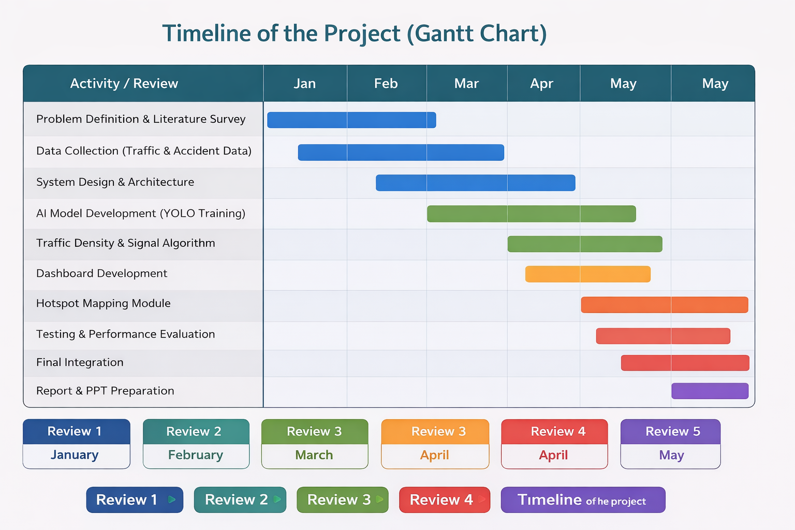
Timeline of the Project (Gantt Chart)

Slide 15
References (IEEE Paper format)
References (IEEE Format):
[1] J. Redmon et al., "You Only Look Once: Unified, Real-Time Object Detection," CVPR, 2016.
[2] Ultralytics, "YOLO26: Key Architectural Enhancements and Performance Benchmarking for Real-Time Object Detection," arXiv:2509.25164, 2025.
[3] IEEE, "IEEE Digital Twin 2025: Fundamentals and Smart City Interaction," IEEE International Conference on Digital Twin, 2025.
[4] T. Williams et al., "Digital Simulation Models for Corrective Actions in Social and Physical Systems," IEEE SWC, 2025.
[5] IEEE, "IEEE Transactions on Intelligent Transportation Systems: Modeling and Simulation," IEEE-ITSS, 2026.
[6] V. Barot et al., "Edge ML Technique for Smart Traffic Management in Intelligent Transportation Systems," IEEE Xplore, 2024.
[7] S. Kumar et al., "Dynamic Game Theory for Adaptive Mode Choice and Traffic Equilibrium," IEEE CDC, 2023.
[8] R. Sharma et al., "Stochastic Cascade Models of Traffic Congestion Cost," arXiv:2502.13944, 2025.

Slide 16
References (IEEE Paper format)
[9] F. Nekouee, "Real-Time Traffic Density Estimation with YOLOv8 Architectures," Kaggle/GitHub Intelligence, 2024.
[11] M. A. Khan, "Automated Traffic Management System Using Deep Learning," 2024 International Conference on Sustainable Computing, 2024.
[10] A. Cho et al., "Fine-Tuning YOLO for Superior Detection in Aerial and Urban Views," IEEE Access, 2024.
[12] R. Srikanteswara, "Emergency Vehicle Recognition Via Automated Smart Traffic Manager," IEEE EASCT, 2023.
[13] V. Chava, "Smart Traffic Management System using Cooperative Adaptive Cruise Control," IEEE ICAAIC, 2023.
[14] P. Viola and M. Jones, "Rapid Object Detection using a Boosted Cascade of Simple Features," CVPR, 2001.
[15] J. Deng et al., "Arc Face: Additive Angular Margin Loss for Deep Face Recognition," CVPR, 2019.

Slide 17


